Slide 1
Unsupervised Chunking for IL (Hindi)
NLP Project
Tanishq Goel
Chayan Kochar

Slide 2
TABLE OF CONTENTS
01
02
03
Abstract
Introduction
Implementation
04
05
06
Observations
Error Analysis
Conclusion
Topic of the section
Concept Learning
How we implemented our model?
Inferences of the Model
Comparison between different models
The end

Slide 3
Abstract
The aim of this project is to create a phrase based chunking algorithm for Indian Languages using unsupervised approach. We utilized clustering techniques to implement this model. Two Algos used for clustering are K-means and Hierarchical which are introduced in the following slides.

Slide 4
Why follow Unsupervised Approach?

Slide 5
PROJECT CHECKPOINTS
GOAL 1
GOAL 2
GOAL 3
GOAL 4
Implementation of the two mentioned clustering algo independent of NLP.
Incorporated NER to take care of a particular case.
Chunking through clustering techniques
Main aspect of the project is to analyse the errors by comparing different models

Slide 6
TIMELINE
2-3rd Week of March
4th Week of March
1-2nd Week of April
3rd Week of April
4th Week of April
Exploration
Implementation of Clustering Techniques
Incorporating NLP
NER implementation to handle some specific case
Modifications in the model and Error Analysis

Slide 7
Clustering Techniques
K-Means Clustering
Hierarchical Clustering

Slide 8
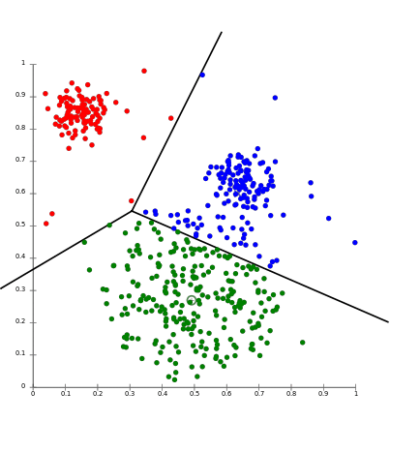
K-Means
The ‘means’ in the K-means refers to averaging of the data; that is, finding the centroid.

Slide 9
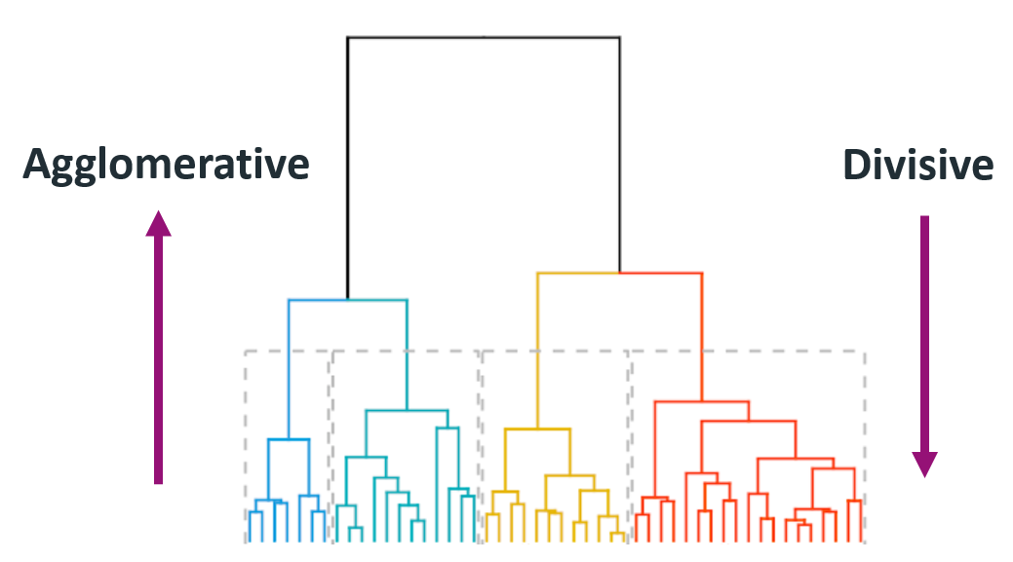
Hierarchical Clustering
Assign each observation to its own cluster. Then,
compute the similarity (e.g., distance) between each of the clusters and join the two
most similar clusters.

Slide 10
Implementation of the model is explained in the report.

Slide 11
Observations

Slide 12
We observed Cases like 'NNP NNP' could not be chunked into one. For example: "Nawab Pataudi" is a one chunk but our model identifies this name as separate two chunks. So if we have a sentence like "Nawab Pataudi ne ....." - so our model correctly identifies to put the postposition with NNP in Noun Phrase, but it can’t chunk between two nouns. Eg: Nawab - B Pataudi - B ne - I ....
When we calculated total number of such chunks, we found occurence is quite low so it doesn't affect the accuracy much. We did tried to incorporate NER model of hindi in the same but as accuracy of Hindi NER Model is quite low, this incorporation wasn't feasible.
Total possible types of noun chunks and verbs chunks were found along with their number of occurrences. Files could be accessed in the observations directory in the repository.
Many tokens, if not were formed part of cluster, were given 'I' tags. Due to this some instances of text like RP* JJ -> JJP were missed.

Slide 13
Conclusion

Slide 14
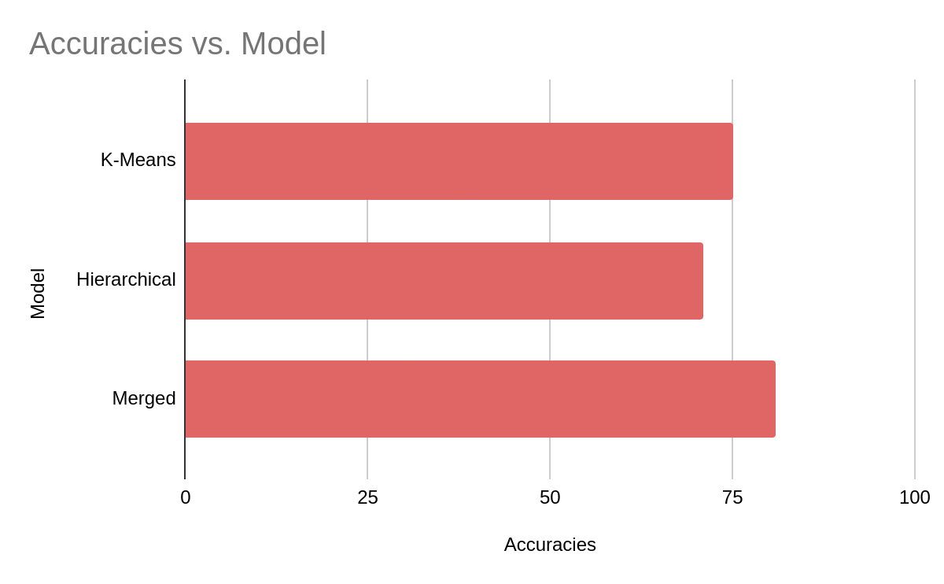
RESULTS
$20,000

Slide 15
~81%
Accuracy

Slide 16
THANK
YOU!!!!!

